Slide 1
Youtube Data Analysis

Slide 2
https://public.tableau.com/views/Tableau_Task_15913413118160/ViewDashboard?:retry=yes&:display_count=y&:origin=viz_share_link
Insight 1
Most of the views has been generated by Florida on Youtube. Also Virginia has least views in youtube. So, that youtube generated it’s most revenue from Florida as compared to Virginia.
Virginia generated nearly 139% less views on Youtube as compared to Florida.
Design: This chart help to understand the number and trend in states also, It easily corelate with data.
Resource-https://www.kaggle.com/datasnaek/youtube-new/data

Slide 3
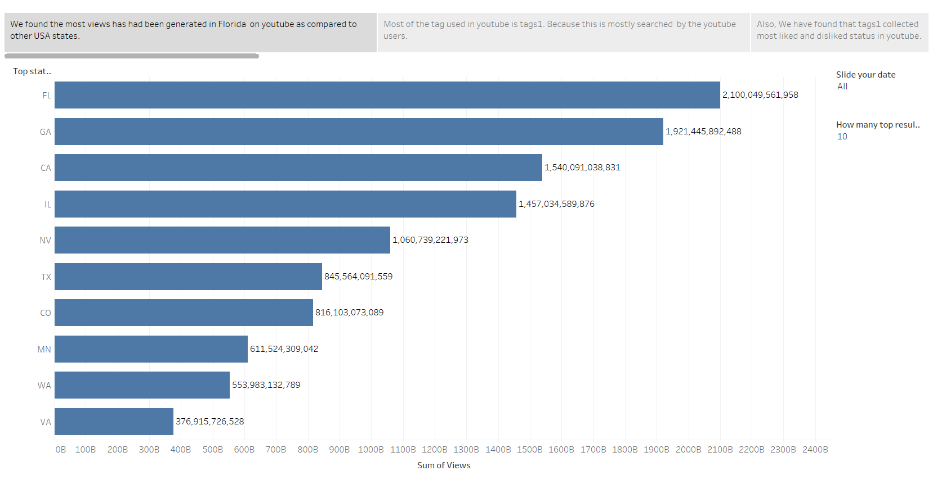

Slide 4
https://public.tableau.com/views/Tableau_Task_15913413118160/TrendingTags?:display_count=y&:origin=viz_share_link
Insight – 2
Tags 1 mostly used in Youtube. Because it contains common phrase which is searched by the users. So, the content creators used Tags1 mostly.
Tags10 used more than Tags1 in videos. Because users are not searching videos using Tags10 as compared to Tags1. Tags10 searched only 22% of the Tags1.
Design: This horizontal bar chart explain number and relation between the trends easily. Also, the fading colors give the idea about strength of users.

Slide 5
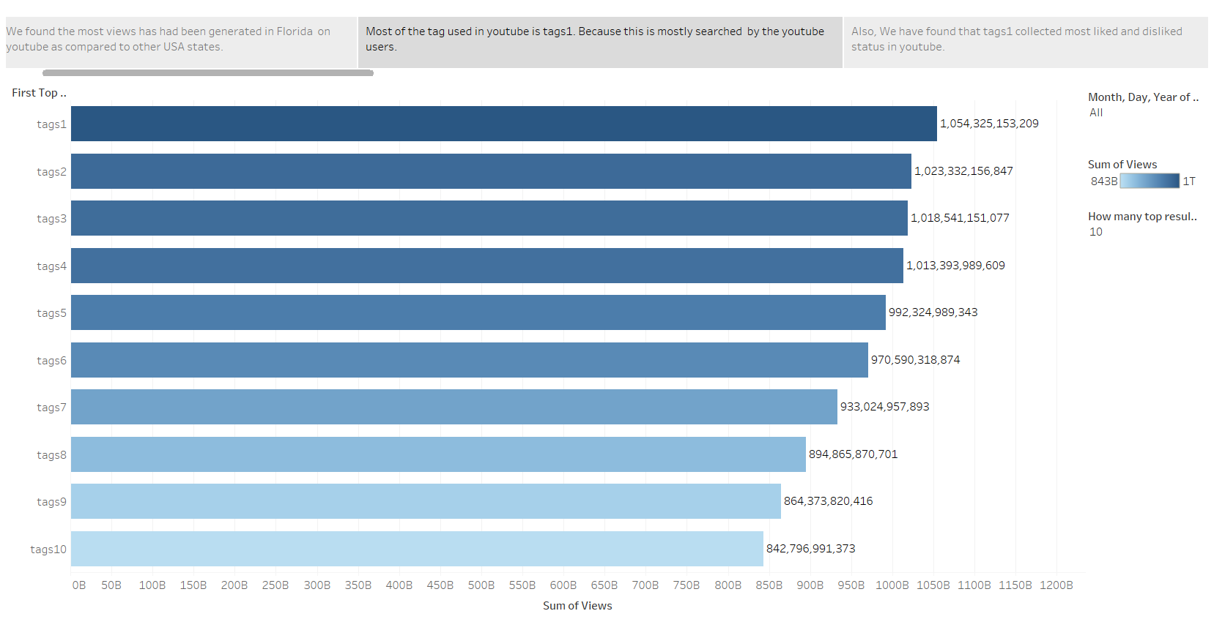

Slide 6
https://public.tableau.com/views/Tableau_Task_15913413118160/MostDislikeVSLike?:display_count=y&:origin=viz_share_link
Insight-3
In this slide we are showing the comparison between likes and dislikes.
Previously, tags1 is most searched and trended tag. Now with comparison, we have witnessed most likes and dislikes also governed by tags1.
Also, Tags10 have minimum dislikes and likes. Because it is least searched and viewed tag as comparison to Tags1.
Design: Butterfly chart help to compare the objects. There it is clearly distinguish two objects likes and dislikes.
Which clearly shown what is the results.

Slide 7
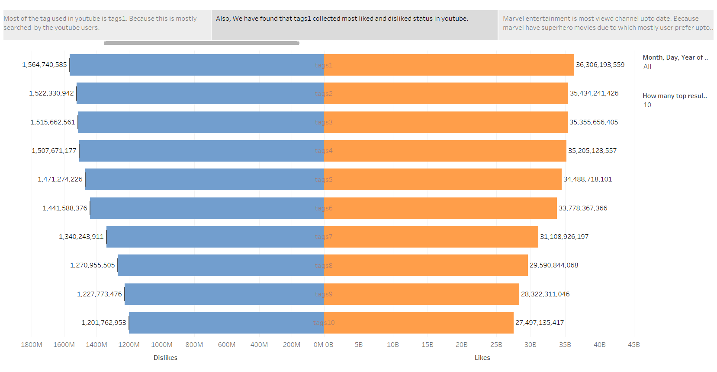

Slide 8
https://public.tableau.com/views/Tableau_Task_15913413118160/MostViewedChannel?:display_count=y&:origin=viz_share_link
Insight- 4
Marvel Entertainment is most watched channel on Youtube. Marvel is comic based entertainment company which publish comics on superhero.
As compared to Marvel, Warner Bros. Pictures has minimum views. Because Warner bros produce DC comics character in their studios which is competitor of Marvel comics. DC comics made most of the film under Warner Bros. Picture.
In conclusion, we seen most of the views generated in superhero based channels.
Also, the entertainment category has most views as compared to education. As we already seen in Category chart all entertainment channel has most views.
Design: This horizontal bar chart describes number and corelate with trend. Standard color has been used because it is not to expressive and not less.

Slide 9
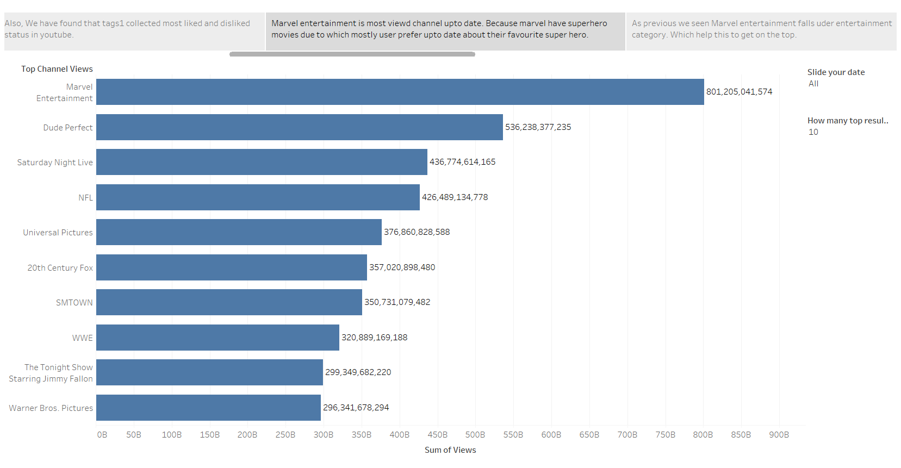

Slide 10
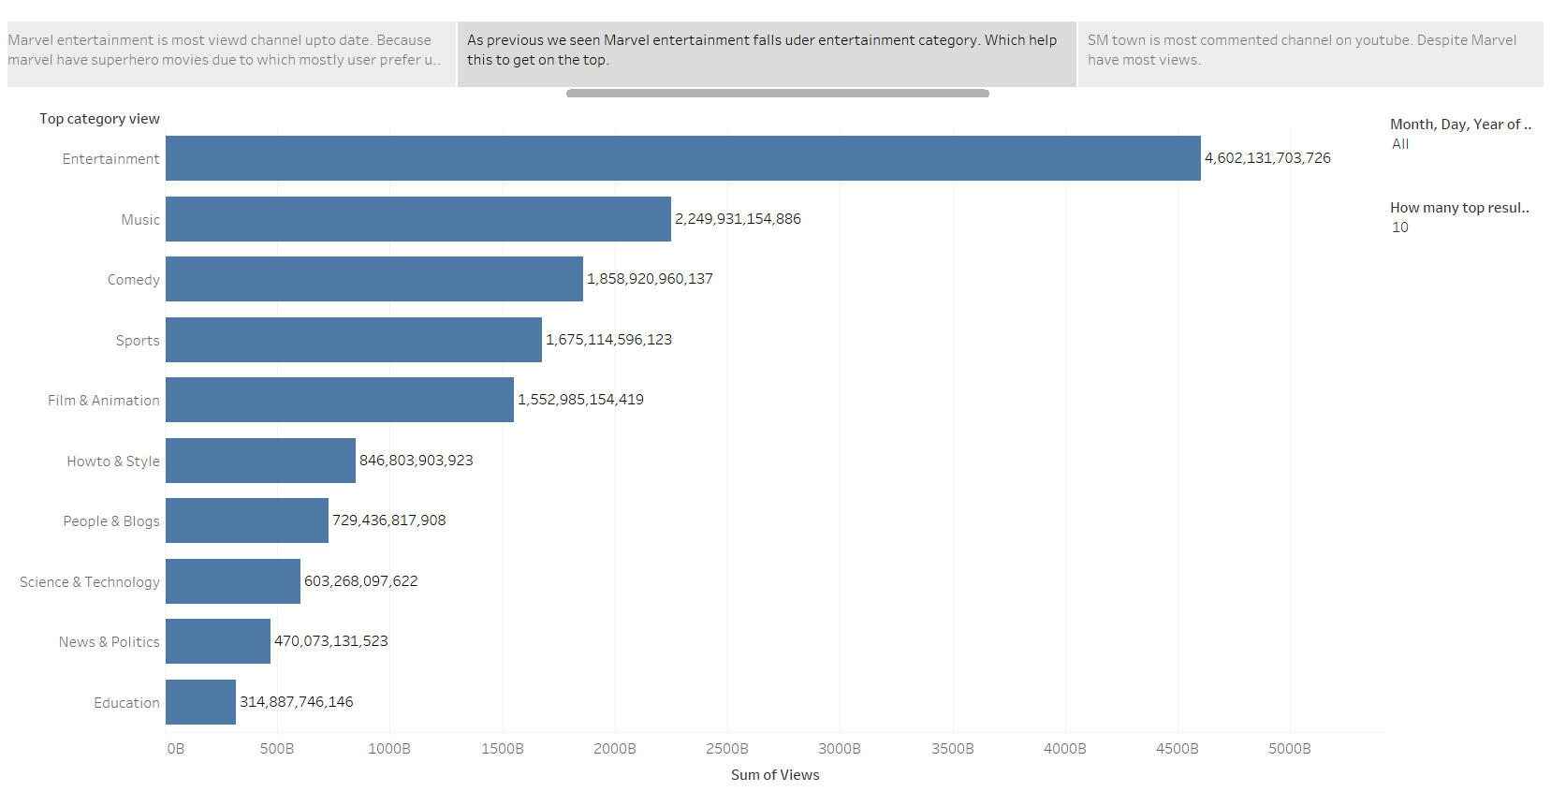

Slide 11
https://public.tableau.com/views/Tableau_Task_15913413118160/Mostcommentedchannels?:display_count=y&:origin=viz_share_link
Insight-5
Most commented channel in SMTown because it is a music channel.
Also, As comparing with top views channel which is Marvel Entertainment. It has less views which 1.25% less from SMTown. Here viewers views most videos of marvel but commenting on SMTown.
Superwomen has less comment on it’s channel because it is a comedy channel which is 104% less compared to SMTown.
Design: We choose this design because the strength of comment easily understandable and colors corelate with comments.

Slide 12
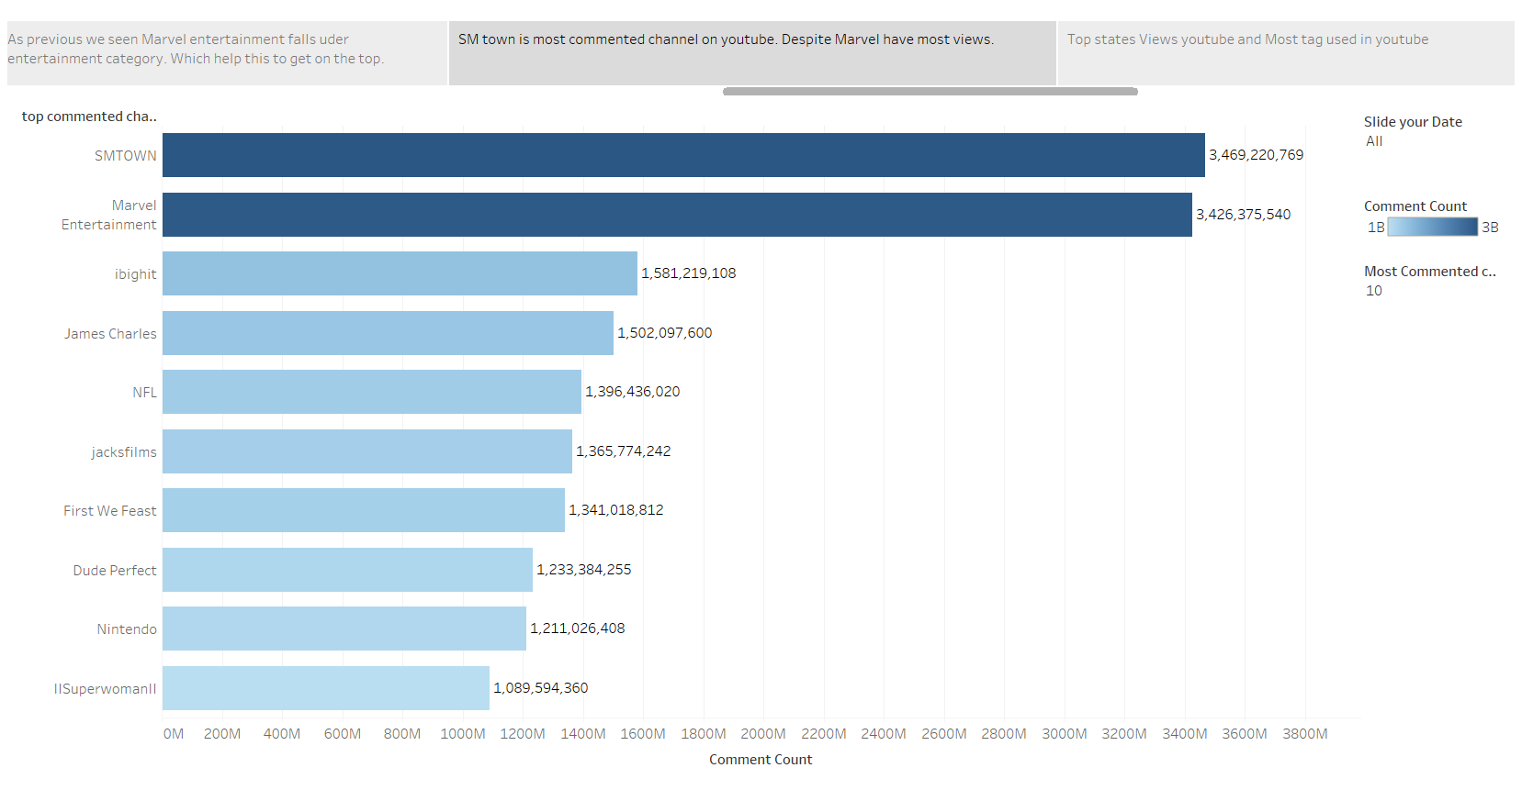

Slide 13
https://public.tableau.com/views/Tableau_Task_15913413118160/ViewDashboard?:display_count=y&:origin=viz_share_link
Insight 1 and 2 conclusion
Here we relate with the most youtube views earned by the florida states and least views earned by Virginia.
California and Illinois has nearly same views.
Tags1 and Tags2 most viewed tag in youtube. Tags 10 has minimum views but Tags10 over the Tags9.
Tags3,4,5 have decent views. Views margin near by 2%.

Slide 14
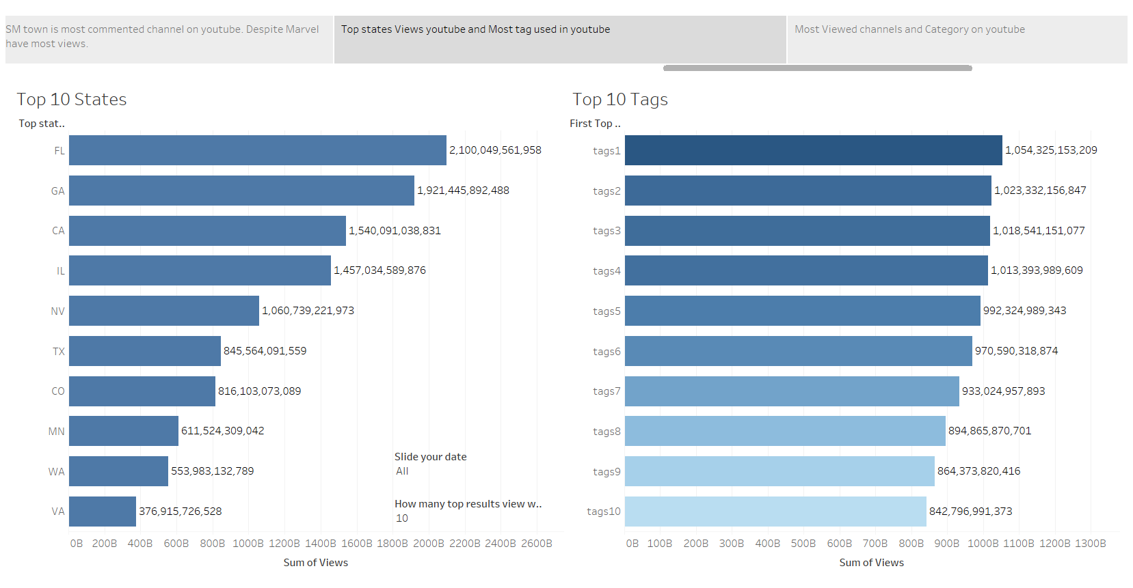

Slide 15
https://public.tableau.com/views/Tableau_Task_15913413118160/DislikeVSlikeandcomment?:display_count=y&:origin=viz_share_link
Insight 3 and 5 conclusion
Tags1 has most likes and dislikes as compared to others. But the tags2 is near to the Tags1 the difference between both dislike is 2.7% and likes 2.4%.
Majorly difference between all tags likes and dislikes (increamental) has difference about 3%.
As we seen most commented channel is SMTown that mean SMTown used to be good music creator.
Marvel entertainment just 1.25% behind to overcome over the SMTown.

Slide 16
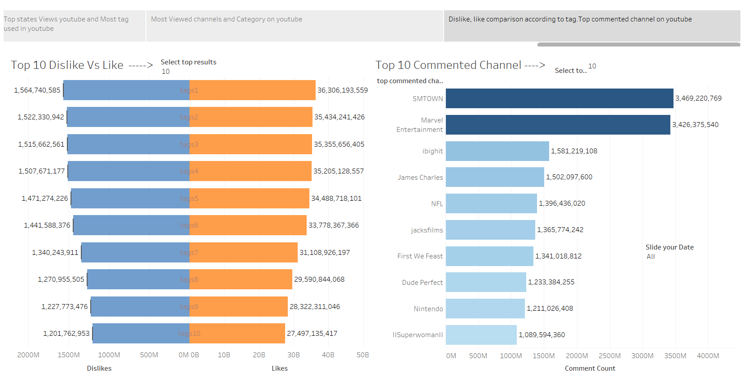

Slide 17
https://public.tableau.com/views/Tableau_Task_15913413118160/MostviewedChannelandCategory?:display_count=y&:origin=viz_share_link
Insight 4 conclusion
Marvel entertainment earned views more than 800B. As compared to Warner Bros.Pictures with views more than 250B.
Saturday night Live, NFL has has similar views with difference 2.4%. With this stats NFL will overcome on SNL.
In category, viewers view entertainment channels for their time pass. As compared to music and others.
People views sports more than Film and animation with difference 7.5%.

Slide 18
